Slide 1

AMAZON TOP SELLING BOOKS FROM 2009 TO 2019-ANALYSIS nam

Slide 2
INTRODUCTION
Dataset on Amazon’s Top selling books from 2009-2019 .it contains 550 books, data has been categorized into fiction and non fiction
The purpose of this is to perform data analysis and extract insights that could help the business model grow, such as the best selling genres, authors and a good price/rating relationship thus company can focus their marketing strategies to improve overall sells.

Slide 3
FEATURES OF THE DATASET
Name: Name of the Book
Author:The author of the Book
User Rating: Amazon User rating
Reviews: Number of written reviews on amazon
Price: The price of the book
Year: Book sold year
Genre: Wheather fiction or non fiction

Slide 4
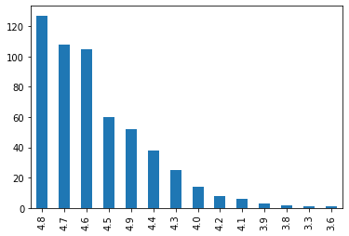
User Rating
-
>User rating is an average of 4.6 ,Highest rating is 4.9 and least is 3.3
->About 180 Books having a rating of 4.8 or 4.9
In the meantime, the rating of 9 books is less than 4.0

Slide 5
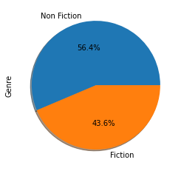
Genre of Books
Genre shows whether the book is fiction or non-fiction. 54.4% are in non-fiction category& 43.6% are in fiction category.

Slide 6
What is the Genre performance as per User rating
 | USER RATING | RATING FICTION | RATING NON-FICTION
YEAR
2009 | 4.587 | 4.592 | 4.577
2010 | 4.558 | 4.615 | 4.520
2011 | 4.558 | 4.619 | 4.514
2012 | 4.532 | 4.495 | 4.559
2013 | 4.554 | 4.546 | 4.562
2014 | 4.622 | 4.631 | 4.610
2015 | 4.648 | 4.653 | 4.645
2016 | 4.678 | 4.716 | 4.655
2017 | 4.660 | 4.737 | 4.588
2018 | 4.668 | 4.738 | 4.617
2019 | 4.740 | 4.820 | 4.687
Since 2012, the books have been performing well in terms of average 'User Rating', showing an increasing trend. In 2016, though, the trend had a small decrease of 0.018.
In performance per genre, we can see that the small decrease was because of a sloppy performance of Non fiction books that year, decrease from 4.655 to 4.588.
Except from 2012 and 2013, Fiction books have been performing better that Non Fiction books

Slide 7
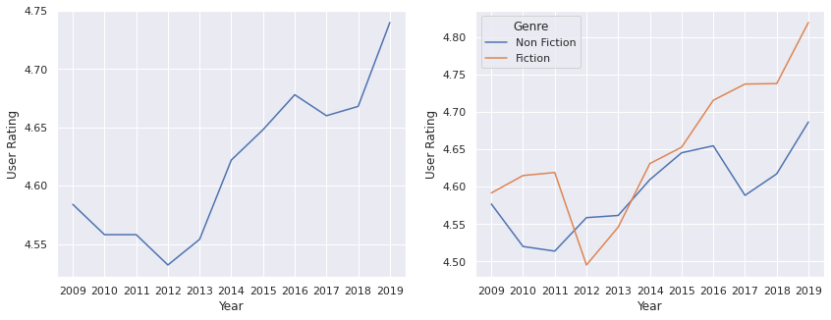
User Rating fiction v/s Non fiction

Slide 8
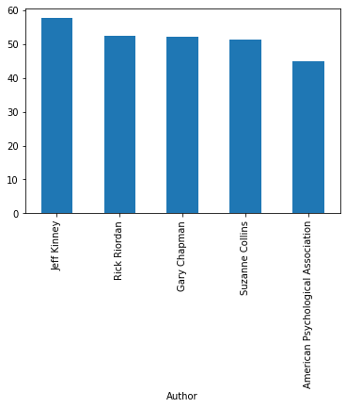
Finding the author names with Highest user Rating
Jeff Kinney :57.6
Rick Riordan: 52.5
Gary Chapman: 52.1
Suzanne Collins :51.3
American Psychological Association :45.0

Slide 9
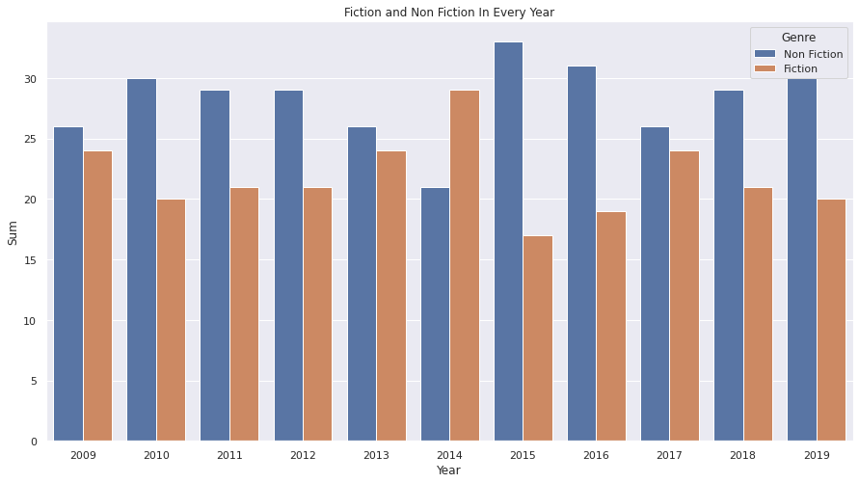
GENERE | FICTION | NON FICTION
YEAR
2009 | 24 | 26
2010 | 20 | 30
2011 | 21 | 29
2012 | 21 | 29
2013 | 24 | 26
2014 | 29 | 21
2015 | 17 | 33
2016 | 19 | 31
2017 | 24 | 26
2018 | 21 | 29
2019 | 20 | 30
Summary of fiction & Non fiction

Slide 10
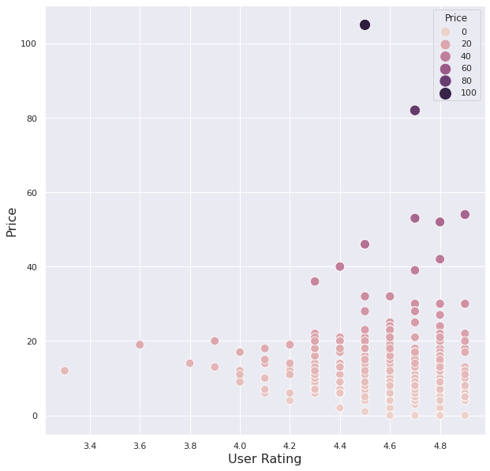
Does price effect User Rating?
The distribution of books by users rating and price.
The highest numbers of books received rating in range of 4.6 - 4.8 points. The price of that books are average.

Slide 11
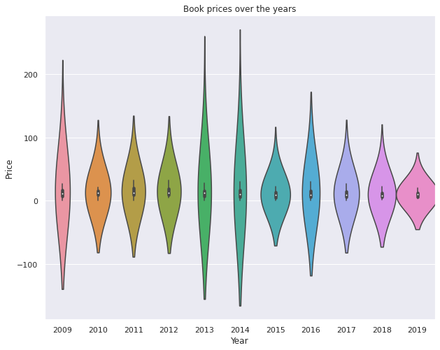
Trends over the Year
This violin plot shows the relationship of year to book pricing. The box plot elements show the median price information for book sold in 2015 was lower than for other years.
The shape of the distribution; the extremely skinny on each end and wide in the middle, indicates that the price of books in year 2009 was higher

Slide 12
Top 3 Based On Highest User Rating In Amazon's Catalogue
Top 3 Based On Highest Reviews Given In Amazon's Catalogue
Name | Author | User rating | Review | Price | Genre | year
The Magnolia story | Chip Gaines | 4.9 | 7861 | 5 | Non fiction | 2016
Dog man:Lord of the fleas | Dav pilkey | 4.9 | 5470 | 6 | fiction | 2018
Dog man:Fetch-22 | Dav pilkey | 4.9 | 12619 | 8 | fiction | 2019

Slide 13
Top 3 Based on Highest selling price in Amazon’s catalogue
Name | Author | User Rating | Reviews | Price | Genre | Year
Diagnostic & statistical manual of mental | Amercan psychaitric association | 4.5 | 6679 | 105 | Non fiction | 2013
Diagnostic & statistical manual of mental | Amercan psychaitric association | 4.5 | 6679 | 105 | Non fiction | 2014
The Twilight saga collection | Stephenia meyer | 4.7 | 3801 | 82 | fiction | 2009

Slide 14
Top 3 Based on Highest Reviews Given in Amazon’s catalogue
Name | Author | User Rating | Reviews | Price | Genre | Year
Where the crawdads sing | Delia owens | 4.8 | 87841 | 15 | Fiction | 2019
The Girl on the train | Paula hawkins | 4.1 | 79446 | 18 | Fiction | 2015
The girl on the train | Paula hawkins | 4.1 | 79446 | 7 | Fiction | 2016

Slide 15
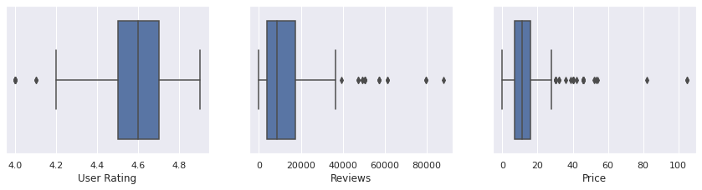
The Graph shows details of Top 3 Books on the Category of Rating, Review and Price

Slide 16
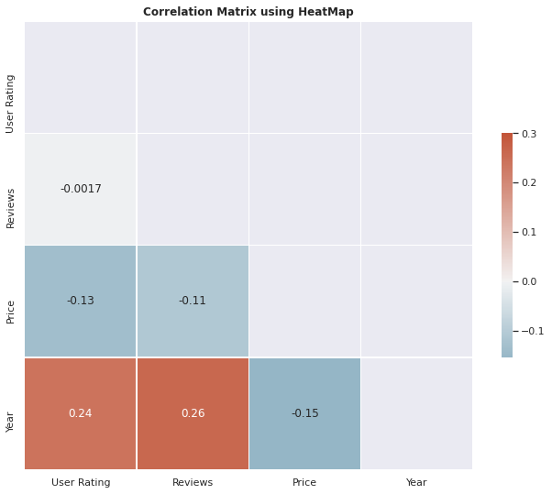
Correlation matix using Heatmap
There is positive correlation between
Reviews' and 'Year‘
'User Rating' and 'Year‘
There is negative correlation between:
'Price' and 'User Rating‘
'Price' and 'Year‘
'Price' and 'Reviews'

Slide 17
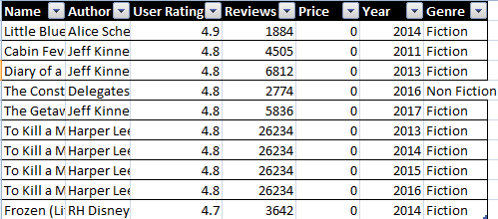
Which are the free books with the best rating?
"Little Blue Truck" by Alice Schertle is the most beloved free book with a user rating of 4.9

Slide 18
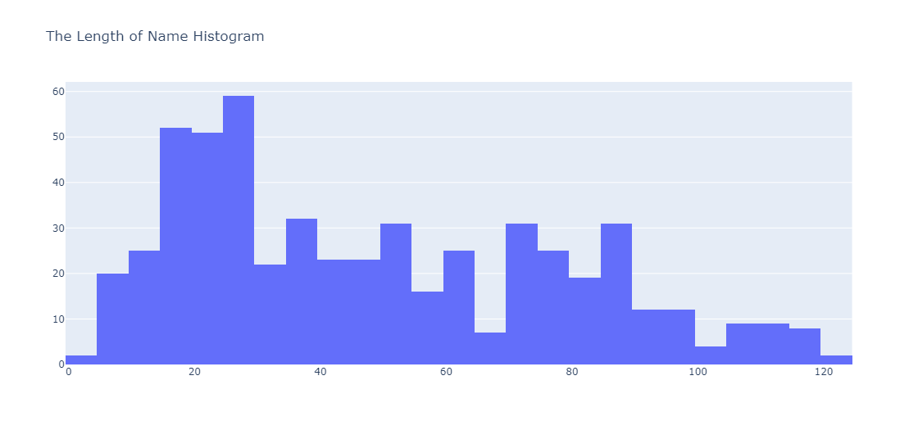
Does the Name of Books affect User Rating
The book which has short title is not always popular, and vice versa.
However, the short title has the advantage of being simple and easy to understand, and the long title has that of giving readers an accurate understanding of what the book is like.

Slide 19
Conclusion
Non-Fiction was a more popular category as compared to Fiction, every year from 2009 to 2019. Out of the 351 unique books, 54.4 percent were Non-Fiction and rest 45.6 percent were Fiction.
The highest fraction (66 percent) of Non-Fiction books were sold in 2015 and lowest for fiction books. For Fiction books, highest fraction (48 percent) of books were sold in 2009, 2013 ad 2017, and lowest for Non-Fiction books.

Slide 20
Author Jeff Kinney is the top selling author with 12 apperences in the top selling books from 2009 to 2019. However, Author EL James has the highest number of reviews on his books.
There are only 2 authors, DK and Scholastic, having books in both the genre category.
The median and mean length of fiction books is less than non-fiction books.
There are total 9 unique books with a price of zero dollar. It can be inferred that these books are either free or its an anomaly. Except for year 2009, the average price of Non-Fiction books is higher than Fiction books each year.

Slide 21
None of the non-fiction books has a rating below 4.
Except for years 2012 and 2013, the average user rating of fiction books is higher than Non-Fictions books each year. Also, the total reviews of Non-Fictions books are higher than Fiction books, except for year 2018 and 2019.

Slide 22


